Slide 1


Brighton Tru-Edge / AMEND
Assessment Report Out
01/05/2023

Slide 2

01
Executive Summary
Agenda
02
Recommended Next Steps
Purpose: Review assessment findings, opportunities, and roadmap recommendations with Brighton Tru-Edge steering team
Desired Outcomes: Alignment on findings, opportunities, and recommendations; discuss proposed next steps
03
Key Themes
04
Discussion

Slide 3



Executive Summary
03
Brighton Tru-Edge is primed to capitalize on the growing cryogenic market over the next 3-4 years. There is an opportunity to improve visibility, communication, data capture, and standardized operational processes.
People: Dedicated, disconnected, aware of improvement possibilities
Knowledgeable core team with a good mix of new and legacy contributors
Tremendous tribal knowledge risk with already decreased knowledge among operators
Minimal departmental visibility creates disruptions in communication and operations
Lacking scorecard to assist holding individuals accountable
Process: Minimal control, lacking workflow efficiency, lacking drive
Operational process improvements are not sustained when business environment changes – must focus on managing change with operations and adjacent departments
Poor process in place to handle escalations and schedule changes
Improvements needed in material movement / job sequencing to keep machines running
Sales and operations planning – visibility needed to bookings, backlog, and billings – enhance conversation for sales to compare current funnel with open capacity
Systems: Inconsistent data, lacking visibility, prone to human error / avoidance
New Scheduling system will upgrade visibility and scheduling process – change management, necessary adaptations, and sustained adoption are key to success
Lack of reporting on real-time and historical operations performance enables circular discussion around standards, operator abilities, and true operational capacity

Slide 4
Recommended Next Steps

Slide 5
Phase 1: Improve Throughput
05
Increase uptime by reducing changeover time, improving material movement, and clearly sequencing jobs. Scale productivity further at key production areas with added observation and workflow enhancements.
SMED Approach to Changeovers, Job Sequencing, & Material Movement
Document key activities and decisions made between jobs – tool / die / equipment changes, material sequencing, next-job communication, schedule changes, data capture, etc.
Develop step-by-step processes and standard times for executing “set-up” and “tear-down” activities
Establish rules for operational decisions and workflows – next-job staging, schedule changes, tool readiness for changeovers, etc.
Key-Area Time Studies & Observations
Observe and document key operator activities at press, flange, and pickling areas
Conduct time studies on actual jobs and collect data regarding time to complete key activities
Identify opportunities for further workflow improvement post-SMED deployment
Workflow Improvements & Simulation Iteration
Iterate simulation results using data collected from time studies
Execute additional workflow improvement opportunities post-SMED deployment

Slide 6
Key Themes

Slide 7
Foundational Improvements Lead to Advanced Insights
07
Instituting foundational operational excellence and data governance elements will drive heightened throughput and set the stage for advanced visibility into historical performance and future expectations.
Operational Excellence
Data & Analytics
Improved Ops Visibility
Improved S&OP Visibility
Recommendations
Deploy SMED approach on material movement and job sequencing to improve uptime at bottleneck areas
Study production at presses, flanges, and pickling areas
Develop solutions to ease workflow around key areas
Engage operations leaders on floor to drive throughput and sustain process improvements
Results
Improved throughput by reducing changeover time
Better standards and accountability expectations
Recommendations
Re-simulate impact of adding equipment capacity
Review production standards and finalize operator expectations
Define and instill production data capture standards
Develop data adherence tools, reporting by employee, equipment, etc.
Results
Accurate data foundation for advanced reporting, analysis, comparison, and planning
Recommendations
Develop automated operations reporting package containing real-time and historical performance
Review and track performance against standards
Identify production staff training needs based on performance to standards
Create and deploy training plan to improve total operator effectiveness
Results
Faster visibility to operational performance to promote corrective action
Targeted training application to improve operator competency
Recommendations
Develop automated report compiling bookings (incoming orders), backlog (orders in queue), and billings (orders invoiced) to build realistic expectations for sales prospecting
Incorporate capacity planning view by equipment group and individual machine to indicate true timelines for current sales funnel opportunities
Results
Align operational capacity and performance with sales activities to drive appropriate customer expectations

Slide 8
Operational Excellence
08
Gaps Overview
There is limited space for staging, especially with new machines
Staging outside/away from machines leads to longer time needed to locate and load product
Staging becomes especially difficult at bottleneck machines – flanging and pickling
Need production leader to drive on 1st shift
No one actively organizing next orders, prepping load/unload, stopping phone/chat sessions, etc.
Without oversight, standard process of writing a product’s next location is not being followed
Operators are responsible for clean-up, loading, unloading, and changeovers
Reduced focus on material handlers compared with years past has contributed to increased downtime
Goal Statement
Increase throughput by reducing changeover time and improving standards and accountability expectations

Slide 9
Data & Analytics
09
Gaps Overview
Lack of confidence in production data input by operators
Default machines incorrectly selected
Inaccurate time entries require manual cleanup
Current production data points do not capture true machine uptime
Production time captured represents time between job’s start and finish
Lack of data segmentation around non-value-add activities required by the job (prep/loading, unloading, cleaning) limits the ability to simulate the operation’s actual execution
Uncertainty surrounding accuracy of time standards
Maintenance hours are not tracked
Current State
Job Time
Goal Statement​
Obtain accurate data for advanced analysis, comparison, and planning
Future State
Actual
Prep/Load
Job Time
Unload
Clean
Expected
Prep/Load
Job Time
Unload
Clean

Slide 10
Improved Ops Visibility
10
Gaps Overview
No ability to track individual operator and/or machine productivity in real time
Performance reviewed retroactively in weekly production meeting for completed jobs
No KPIs identified to understand operator productivity / performance
Issues on the floor are resolved but not corrected to prevent future mistakes
Production trending is based on gut feel and anecdotal evidence
Training new operators currently taking up to 3-12 months
Some operators tasked with training are not quality trainers
No documented expectations for training progression
Goal Statement
Enable faster visibility to operational performance to promote corrective actions and target training to improve operator competency

Slide 11
Improved S&OP Visibility
11
Gaps Overview
"Sales-driven shop“ – not necessarily a bad thing, though clear boundaries are lacking, creating tension between Sales and Operations
No schedule “lockdown” period – production schedule routinely changes last minute, causing scrambles
Accommodating to high priority and loudest customers
May lead to unexpected changeovers, non-staged product, and decreased uptime
Erodes momentum behind process improvement efforts and enables bad habits
Communicated customer lead times may not represent production’s true ability to deliver
Leads to disappointed customers where quoted lead times cannot be met
Goal Statement
Align operational capacity and performance with sales activities to drive appropriate customer expectations

Slide 12
Discussion

Slide 13
Phase 1: Improve Throughput
13
Increase uptime by reducing changeover time, improving material movement, and clearly sequencing jobs. Scale productivity further at key production areas with added observation and workflow enhancements.
SMED Approach to Changeovers, Job Sequencing, & Material Movement
Document key activities and decisions made between jobs – tool / die / equipment changes, material sequencing, next-job communication, schedule changes, data capture, etc.
Develop step-by-step processes and standard times for executing “set-up” and “tear-down” activities
Establish rules for operational decisions and workflows – next-job staging, schedule changes, tool readiness for changeovers, etc.
Key-Area Time Studies & Observations
Observe and document key operator activities at press, flange, and pickling areas
Conduct time studies on actual jobs and collect data regarding time to complete key activities
Identify opportunities for further workflow improvement post-SMED deployment
Workflow Improvements & Simulation Iteration
Iterate simulation results using data collected from time studies
Execute additional workflow improvement opportunities post-SMED deployment

Slide 14
Appendix

Slide 15
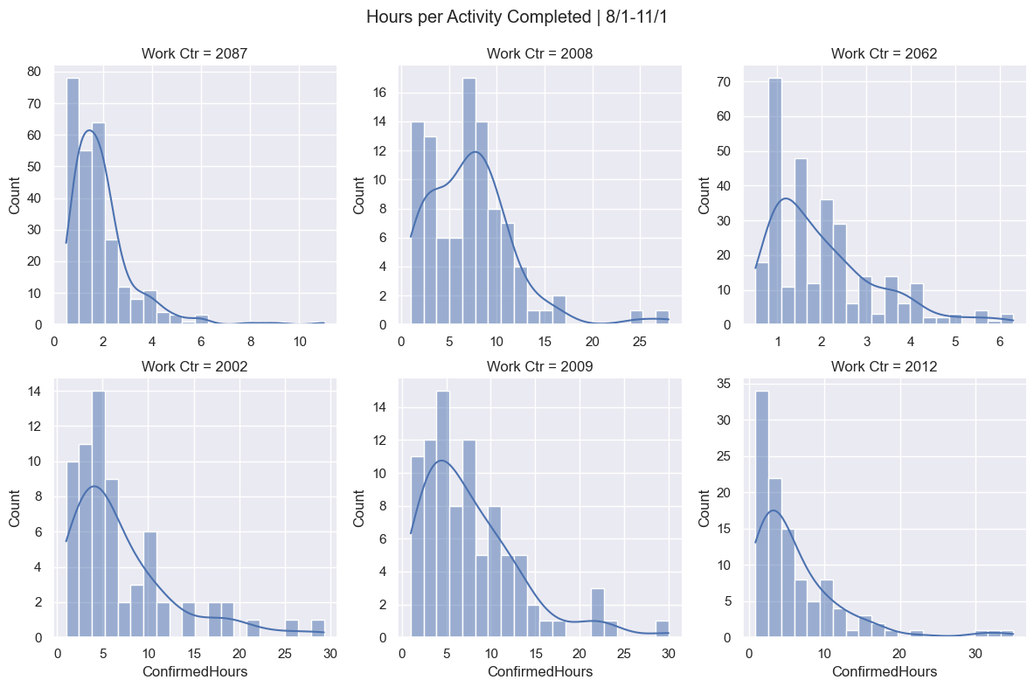
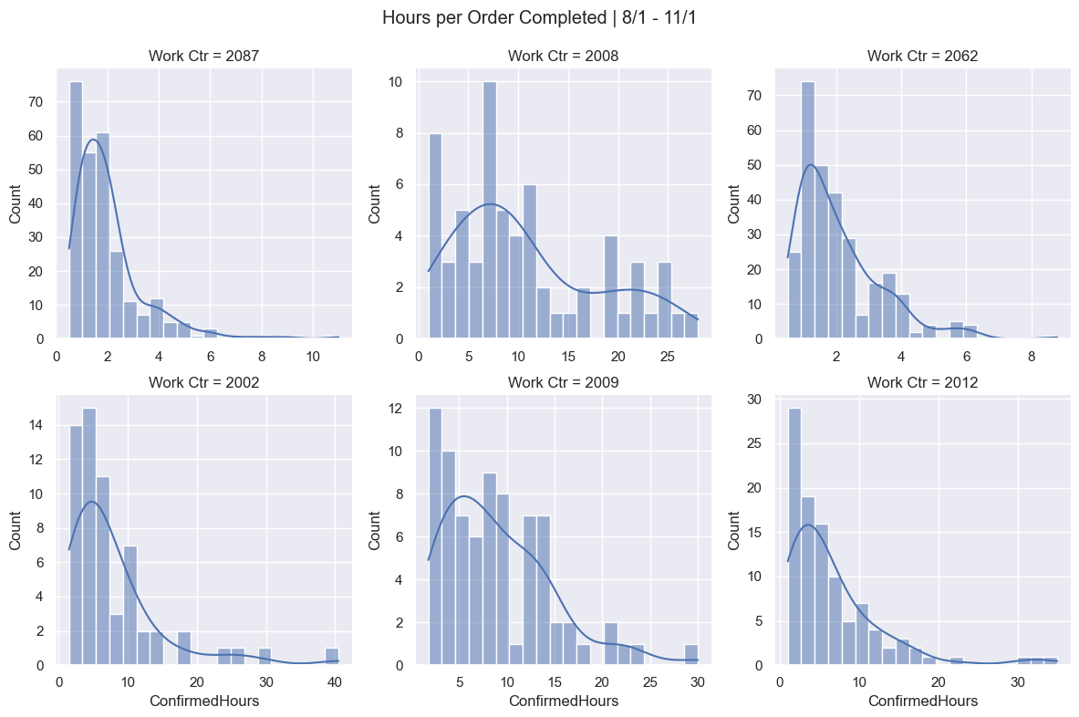
Production time distribution
15
Flange and pickle work centers

Slide 16
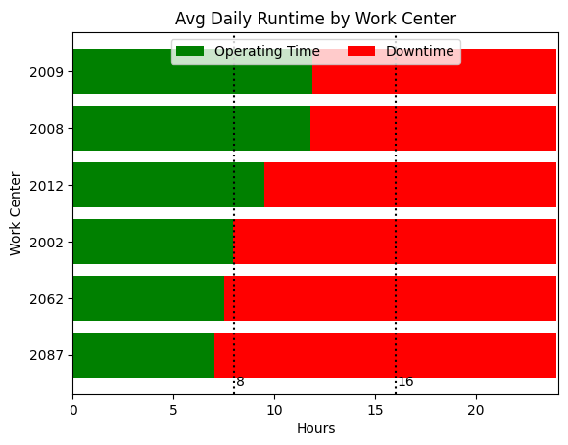
Machine up time
16
Flange and pickle work centers

Slide 17
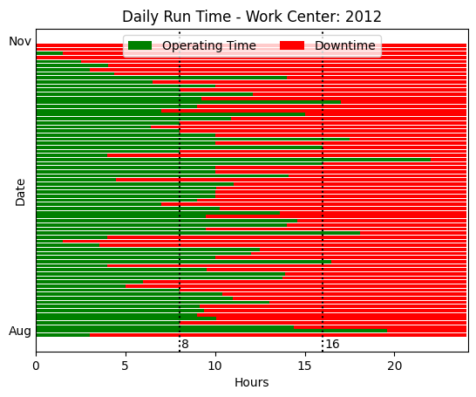
Machine up time
17
Flange and pickle work centers

Slide 18
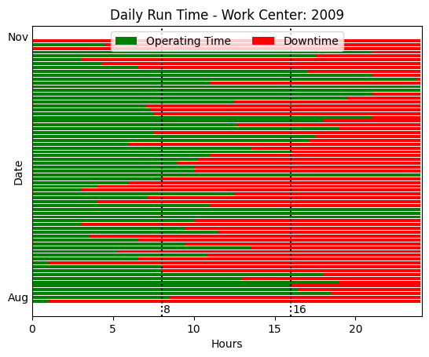
Machine up time
18
Flange and pickle work centers

Slide 19
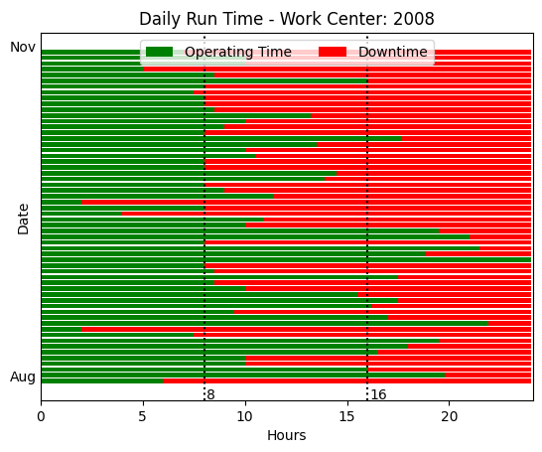
Machine up time
19
Flange and pickle work centers

Slide 20
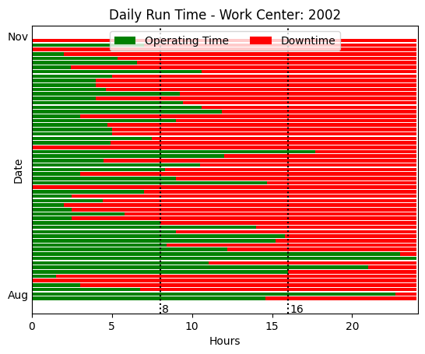
Machine up time
20
Flange and pickle work centers

Slide 21
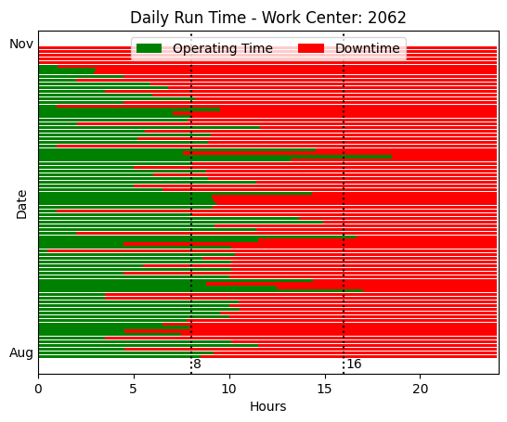
Machine up time
21
Flange and pickle work centers

Slide 22
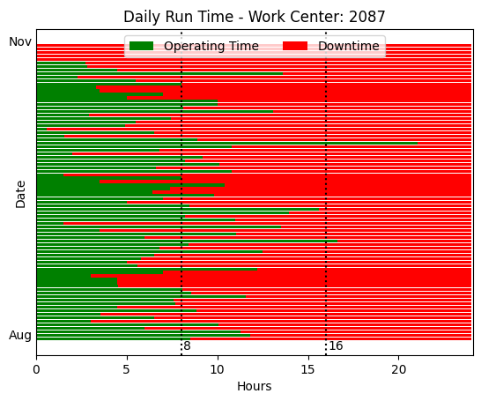
Machine up time
22
Flange and pickle work centers

Slide 23
Thank You

